Slide 1

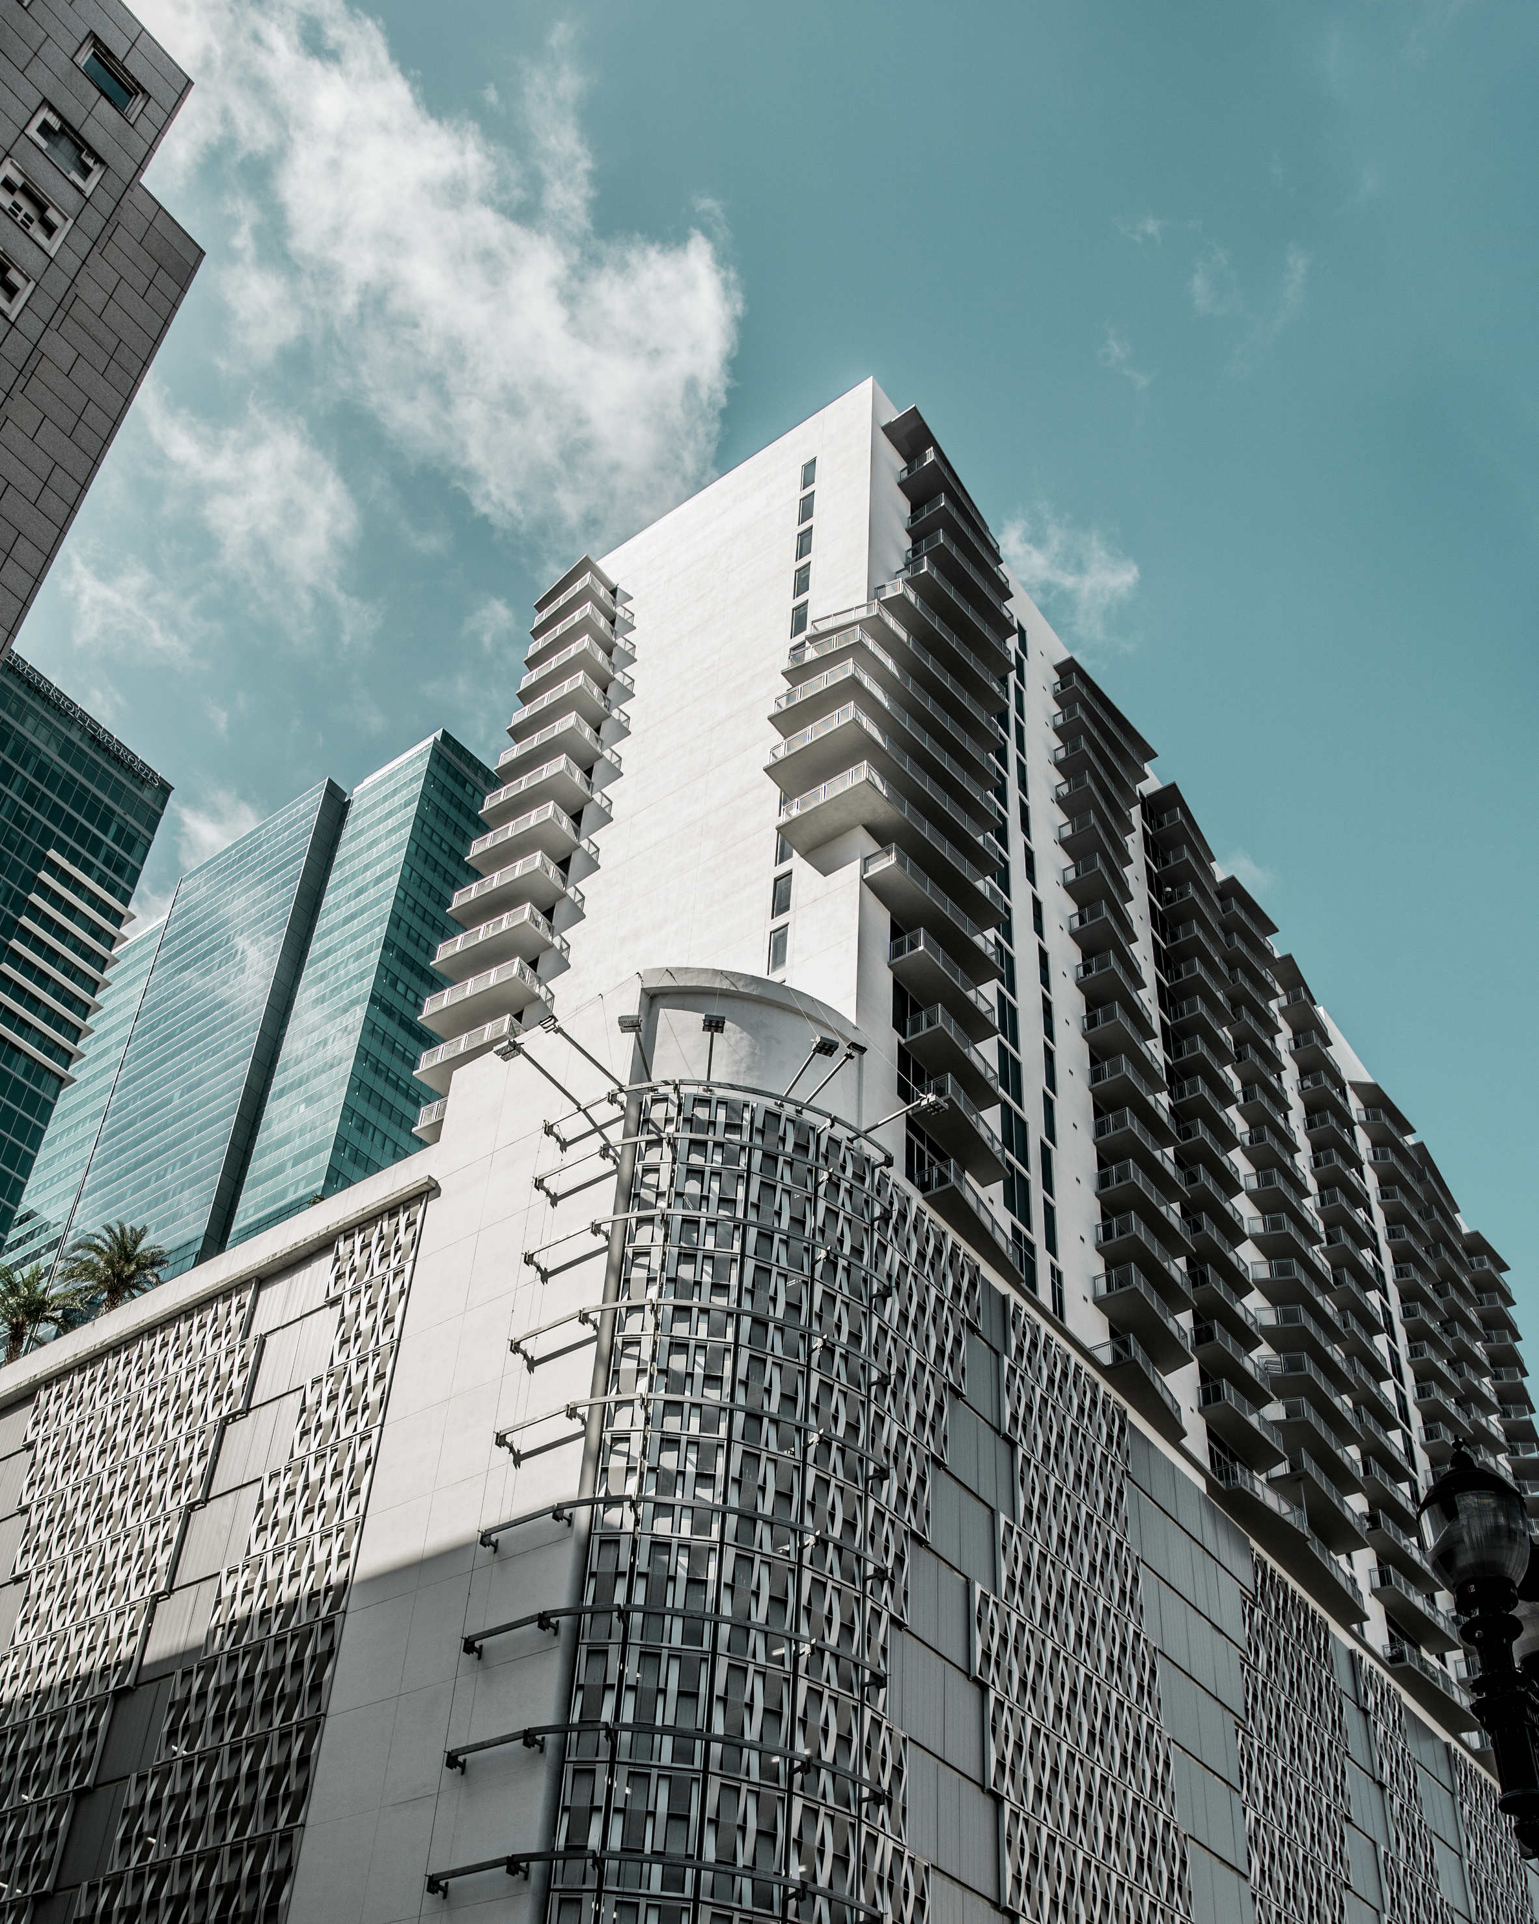
2026
COMPANY PROFILE
ALU GEN ALUMINIUM AND GLASS SOLUTIONS

Slide 2

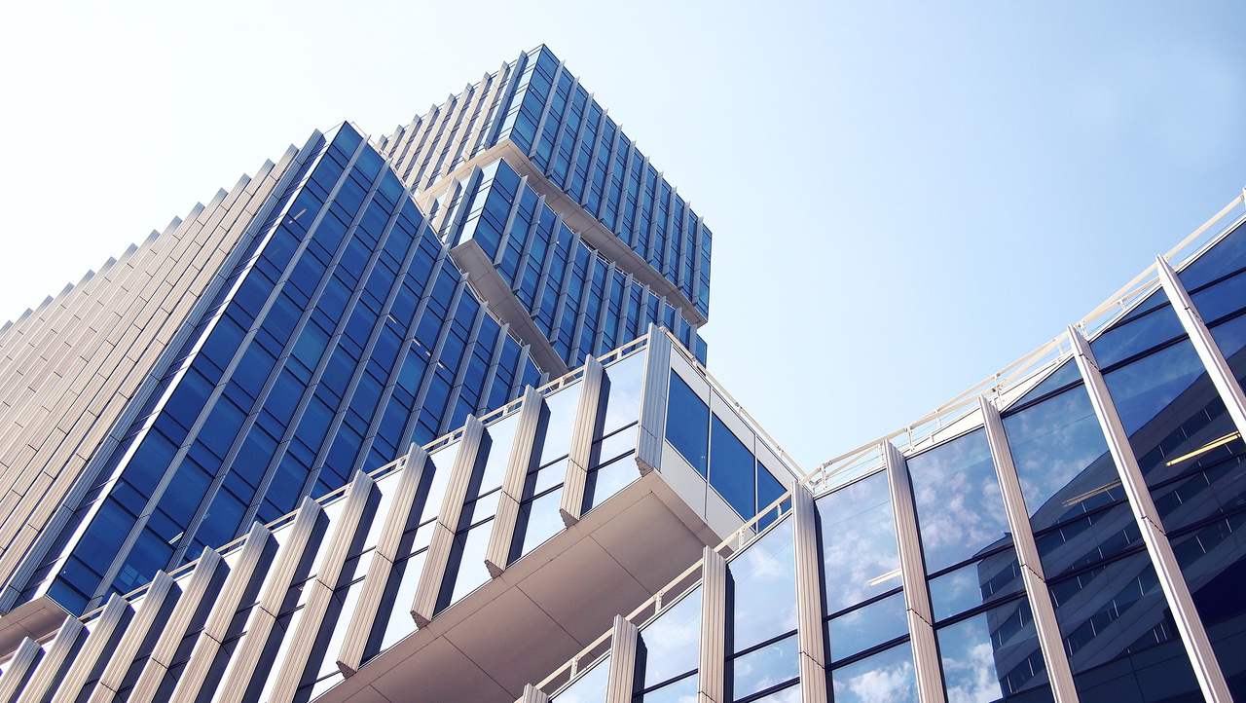
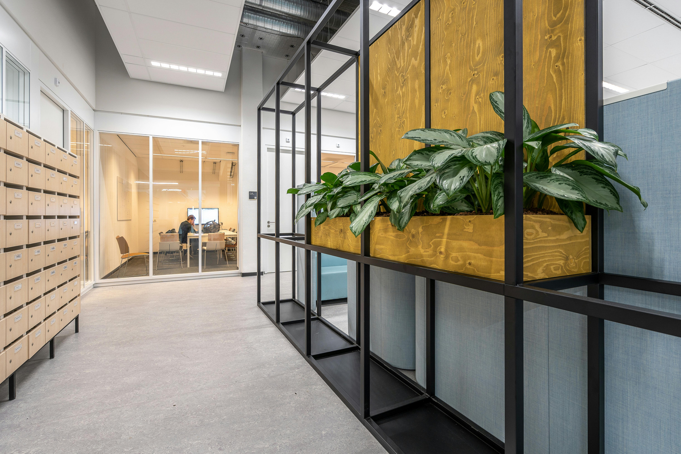
ABOUT US
Founded in 2023, AluGen has established itself as an established provider of aluminium and glass solutions across Pretoria, Moloto, and Siyabuswa.
We specialise in the manufacturing, supply, and installation of high quality aluminium doors, windows, shopfronts, balustrades, garage doors — as well as refurbishment and renovation projects that modernise existing buildings.
Beyond our installation expertise, AluGen is also a trusted supplier of aluminium profiles and accessories to fabricators, supporting the broader construction and manufacturing industry with reliable materials and competitive pricing.
Through strong supplier relationships and an efficient supply chain, we deliver exceptional value and fast turnaround times, ensuring projects stay on schedule and within budget.
All AluGen products are manufactured in accordance with required standards, guaranteeing durability, safety, and style for every installation.
WWW.ALUGEN.CO.ZA

Slide 3
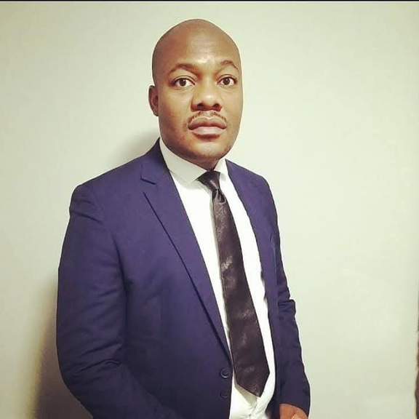
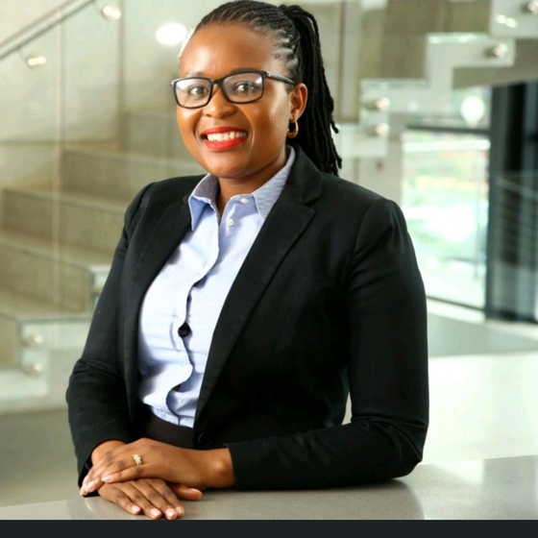
OUR DIRECTORS
Leadership that blends executive precision and technical craftsmanship
James Manabile
Queen Tsoai
Managing Director (MD)
Chief Operating Officer (COO)
A seasoned professional with 8 years of experience in the aluminium industry. Expert in sales, marketing, and glass product applications. He oversees client engagement, product innovation, and market development.
MBA, BCompt, SAIPA
A finance and operations executive with extensive experience in business management and project execution. She leads our strategic direction, client relations, and operational excellence.
Our partnership blends executive precision and technical craftsmanship, ensuring that every installation meets the highest standards of quality, compliance, and aesthetic design.

Slide 4

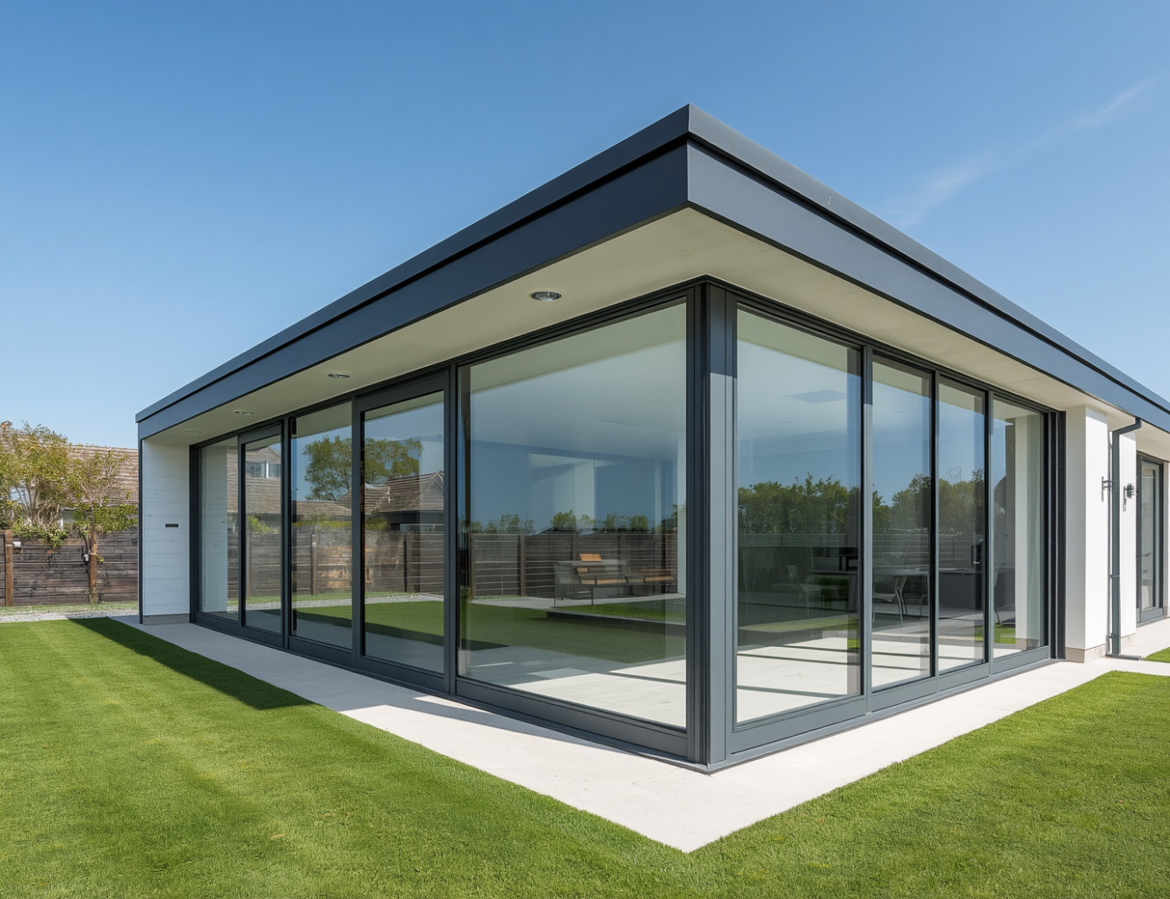
WHO WE ARE
Our Identity
AluGen delivers premium aluminium frames, glass installations, shopfronts, and architectural features for modern estate-grade homes. Built on precision engineering and premium materials, we bring executive-level project management to every installation.
Our Core Pillars
Precision Engineering — Laser-measured accuracy and expert fabrication for a perfect fit every time. Premium Materials — High-grade aluminium profiles and safety glass for lasting performance. Executive Project Management — Clear timelines, transparent pricing, and snag-free handover.

Slide 5
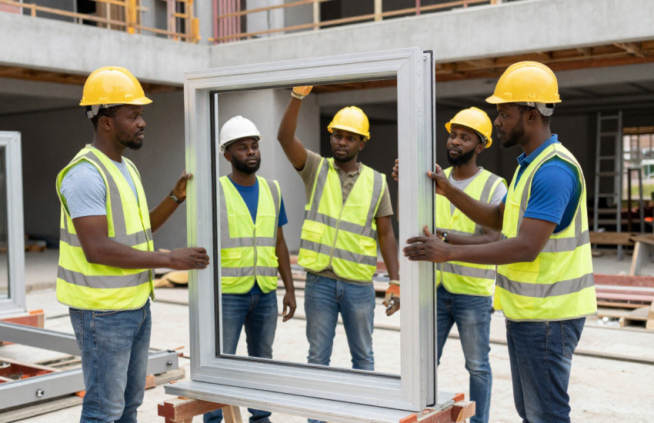
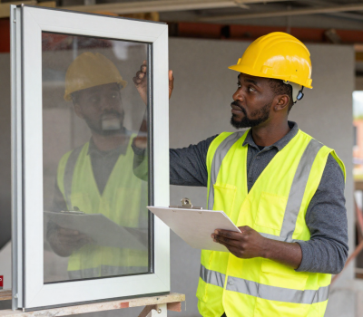
OUR TEAM
Building futures through people
Alu Gen and Glass is committed to job creation and the continuous development and training of our teams. We believe that investing in our people is investing in the quality of every project we deliver. Through hands-on mentorship, skills development programmes, and a culture of growth, we empower each team member to reach their full potential while contributing to the communities we serve.

Slide 6

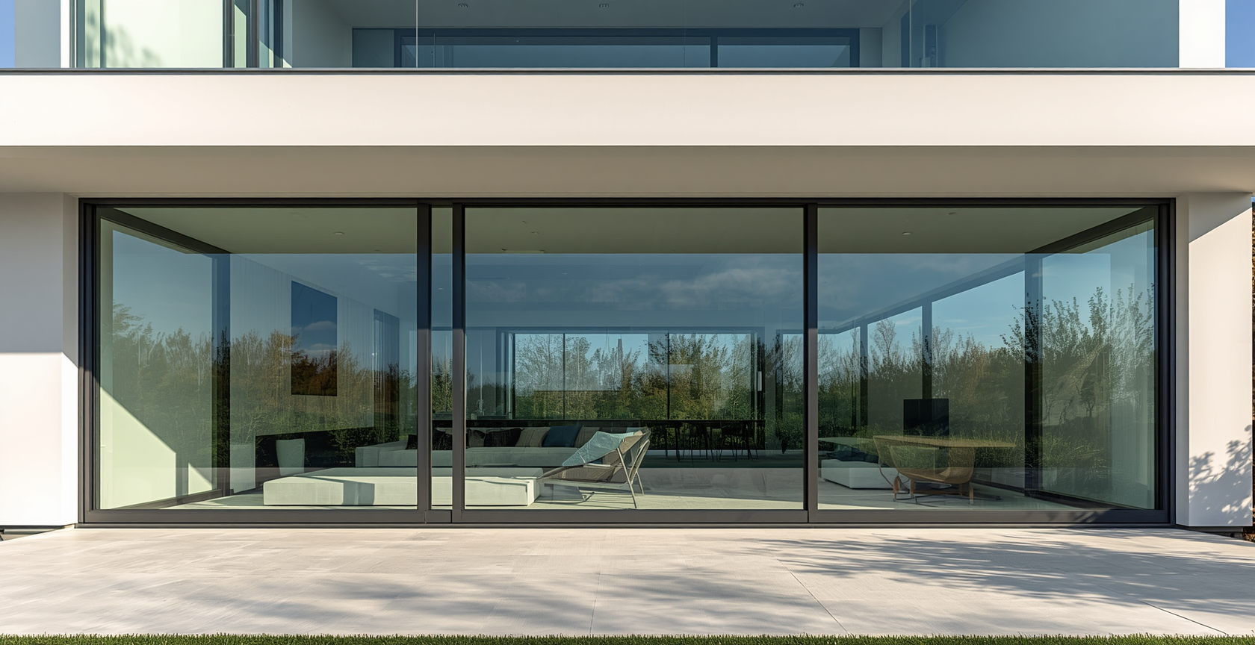
2026
ALUGEN ALUMINIUM & GLASS SOLUTIONS
PREMIUM ALUMINIUM & GLASS INSTALLATIONS FOR MODERN HOMES

Slide 7
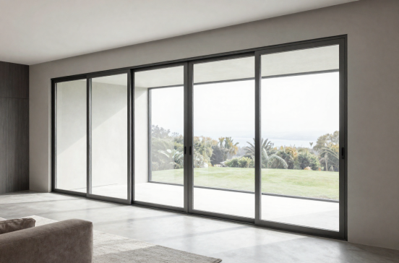
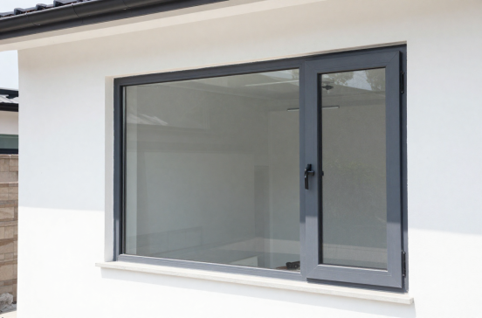
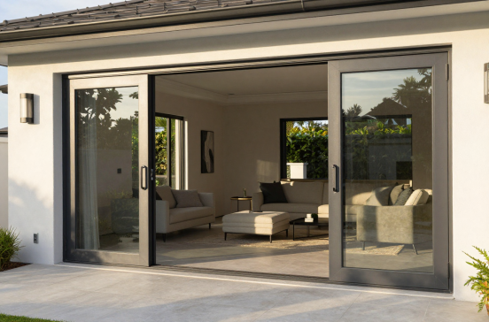
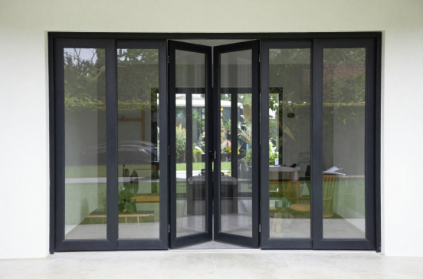
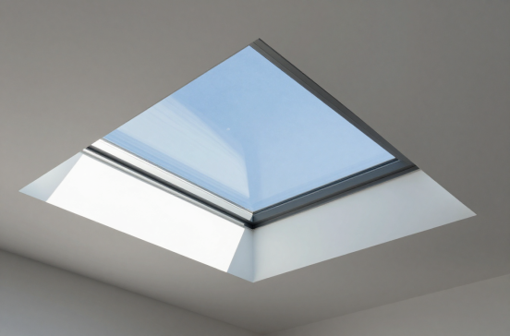
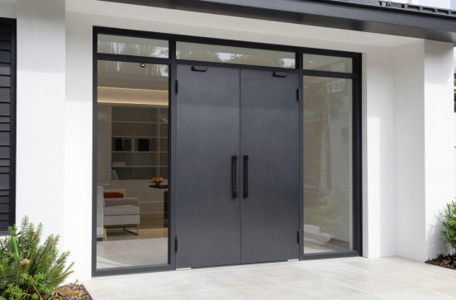
OUR PRODUCTS
Premium Aluminium & Glass Solutions
Sliding Doors
Windows
Stacking Doors
Folding Doors
Sky Lights
Pivot Doors

Slide 8
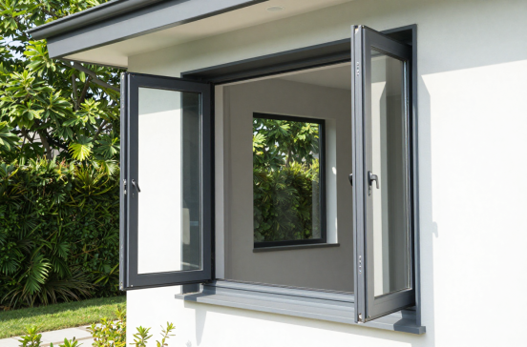
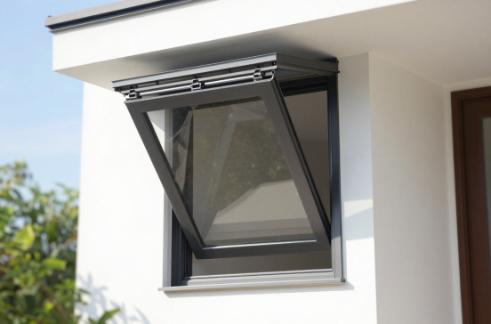
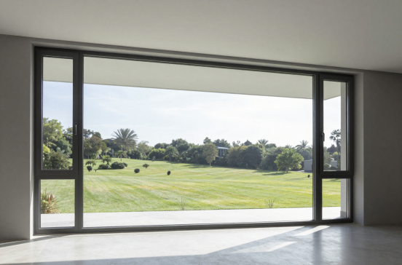
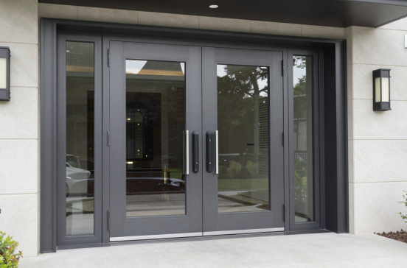
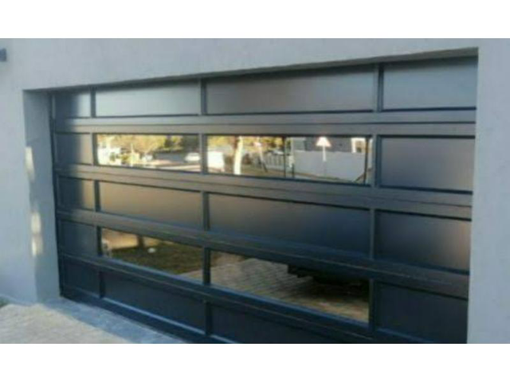
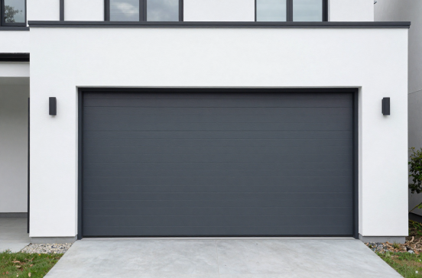
MORE PRODUCTS
Windows & Garage Door Solutions
Casement Windows
Awning Windows
Fixed Windows
Pivot Doors
Roll-Up Garage Doors
Modern Garage Doors

Slide 9
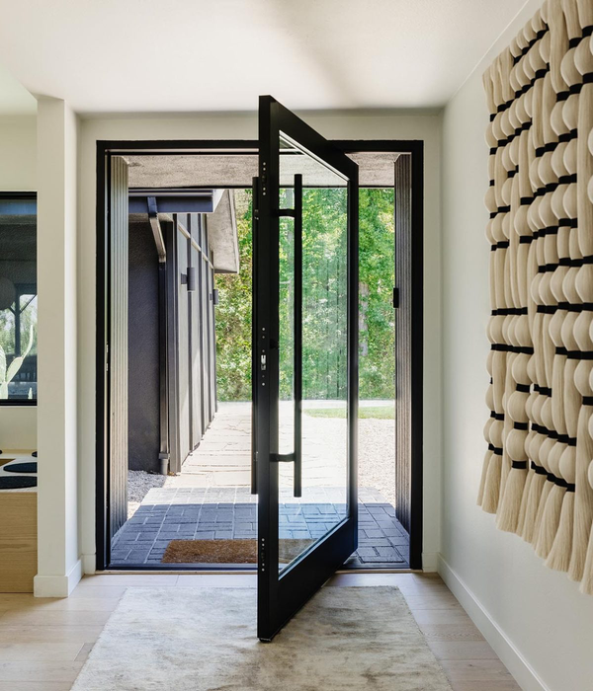
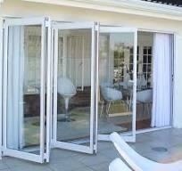
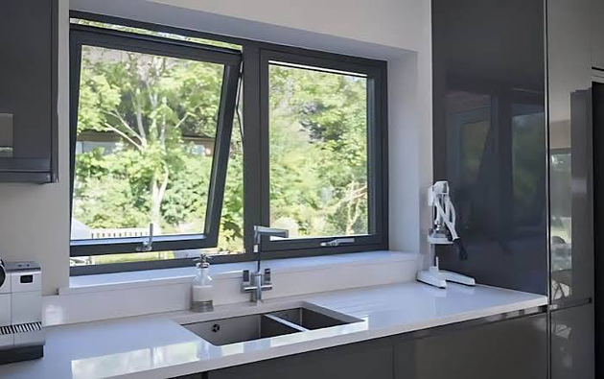
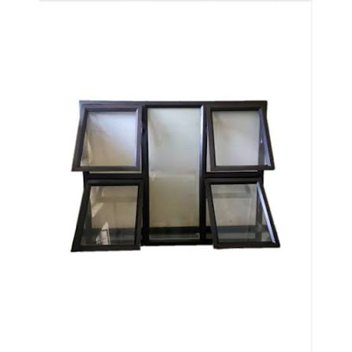
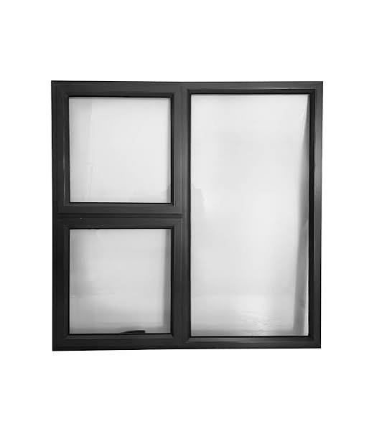
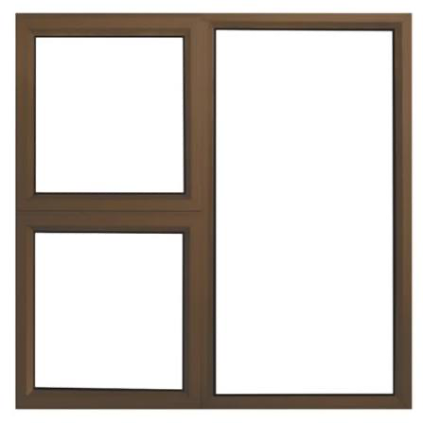
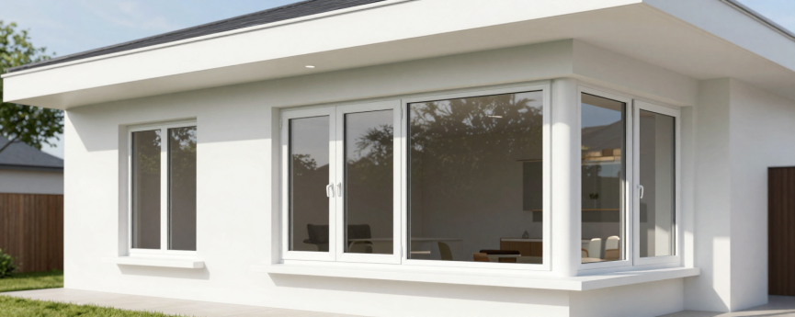
MORE PRODUCTS
White Aluminium Windows

Slide 10
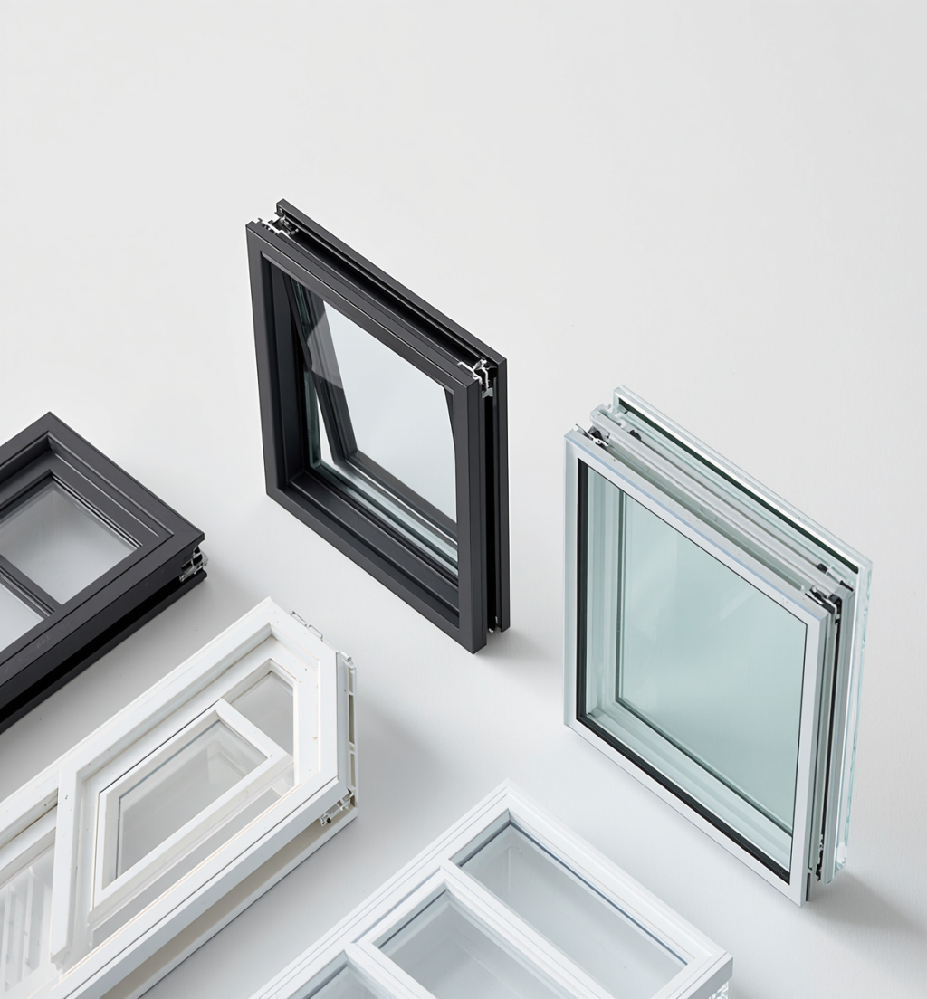

COLOURS & GLASS OPTIONS
COLOUR FINISHES
Charcoal | Black | Bronze | White | Custom Colours
All frames are premium powder-coated to estate-approved specifications, ensuring durability and a flawless finish that complements modern architectural styles.
GLASS OPTIONS
• Laminated Glass — safety and acoustic performance
• Toughened Glass — high-impact strength and safety
• Double Glazing — superior thermal insulation
• Low-E Energy-Efficient Glass — reduced heat transfer, lower energy costs
Bronze

Slide 11
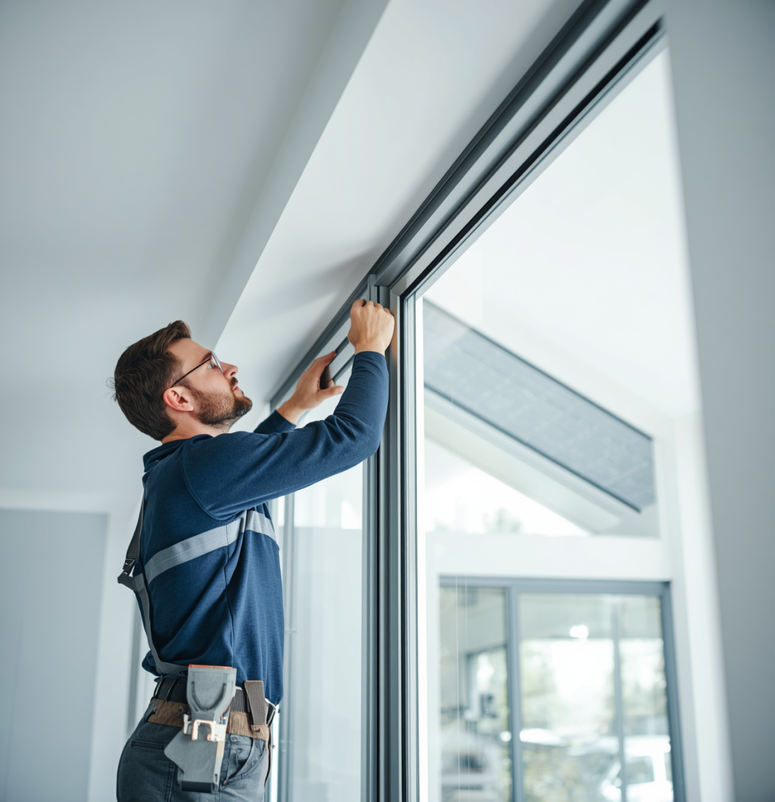
CORE CAPABILITIES
Aluminium Windows
Custom Sizes
Sliding & Stacking Doors
Reinforced Profiles
Pivot & Hinged Doors
Modern Hardware
Glass & Shopfronts
Balustrades & Features

Slide 12

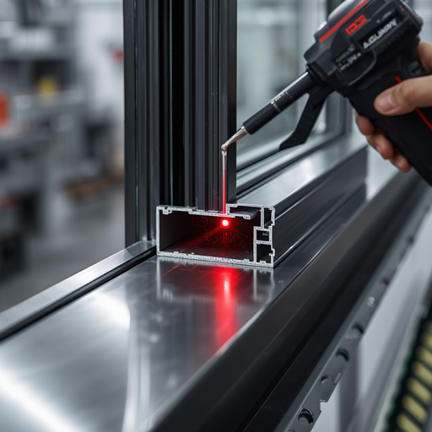
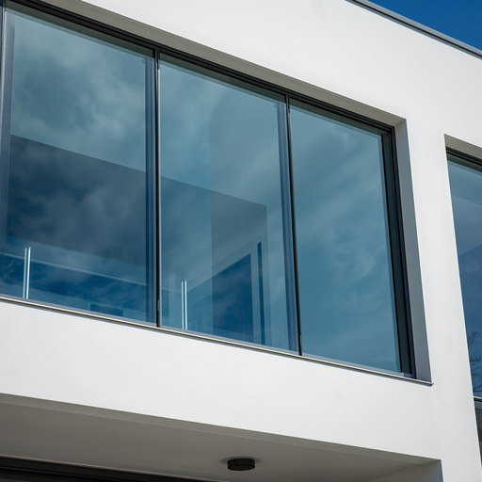
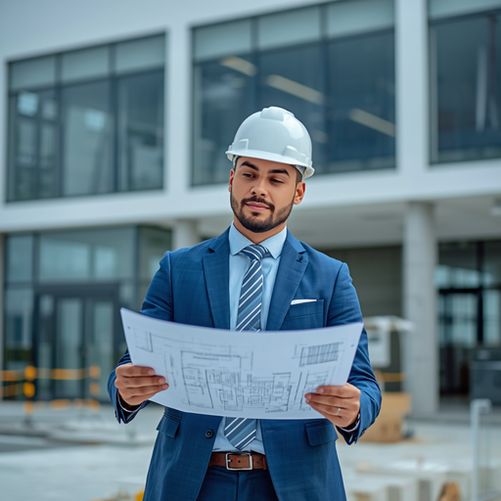
WHY CLIENTS CHOOSE US
Precision & Quality
Compliance & Safety
Project Management
Laser-measured accuracy & premium powder-coated finishes
Clear timelines, transparent pricing & snag-free handover

Slide 13
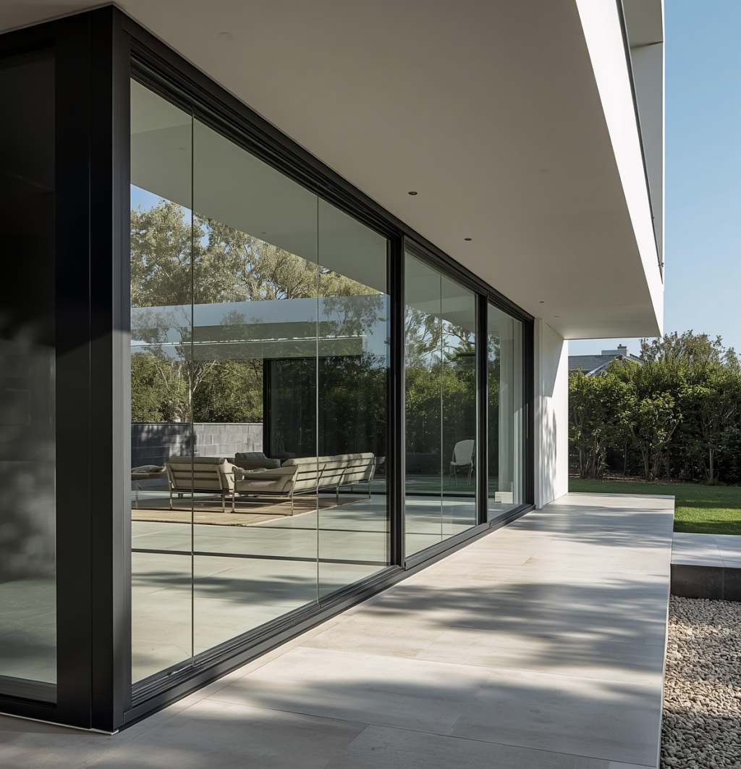
ESTATE LIVING
Specialising in oversized openings, custom architectural profiles, and estate colour guidelines — engineered to meet estates strict aesthetic standards and modern architectural vision.
Our solutions are designed to complement high-end finishes, bespoke frame profiles, and estate-approved colour palettes — delivering a seamless, premium result for every Copperleaf installation.

Slide 14
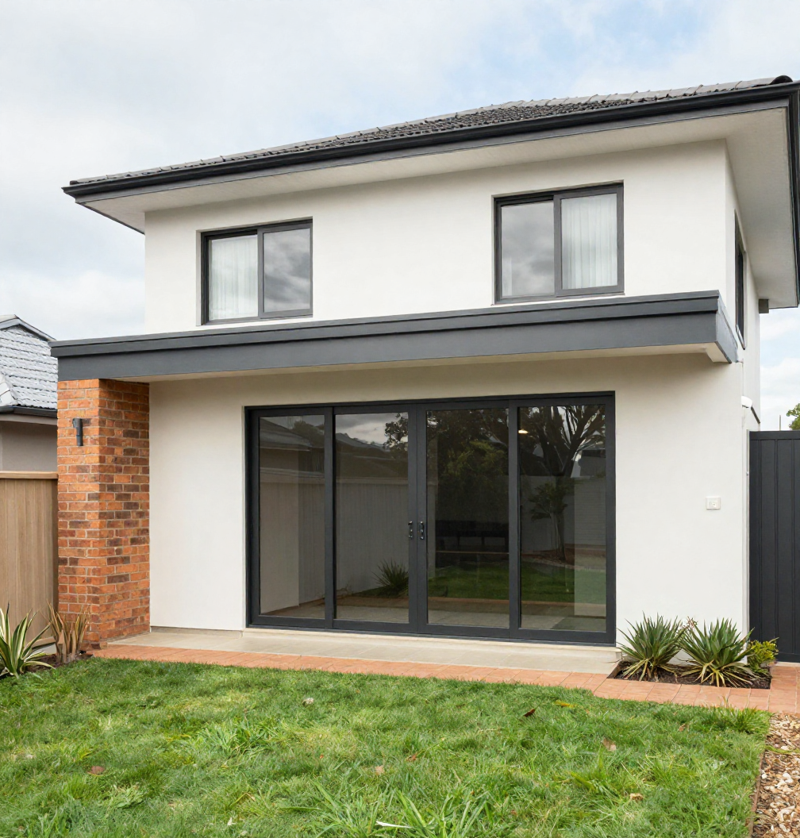
SUBURB LIVING
Designed for modern suburban homes — stylish aluminium windows, sliding doors, and security features that enhance curb appeal while maximising natural light and ventilation.
Our suburb installations combine sleek aluminium frames with energy-efficient glass, offering homeowners a contemporary upgrade that adds lasting value and everyday comfort to family living spaces.

Slide 15
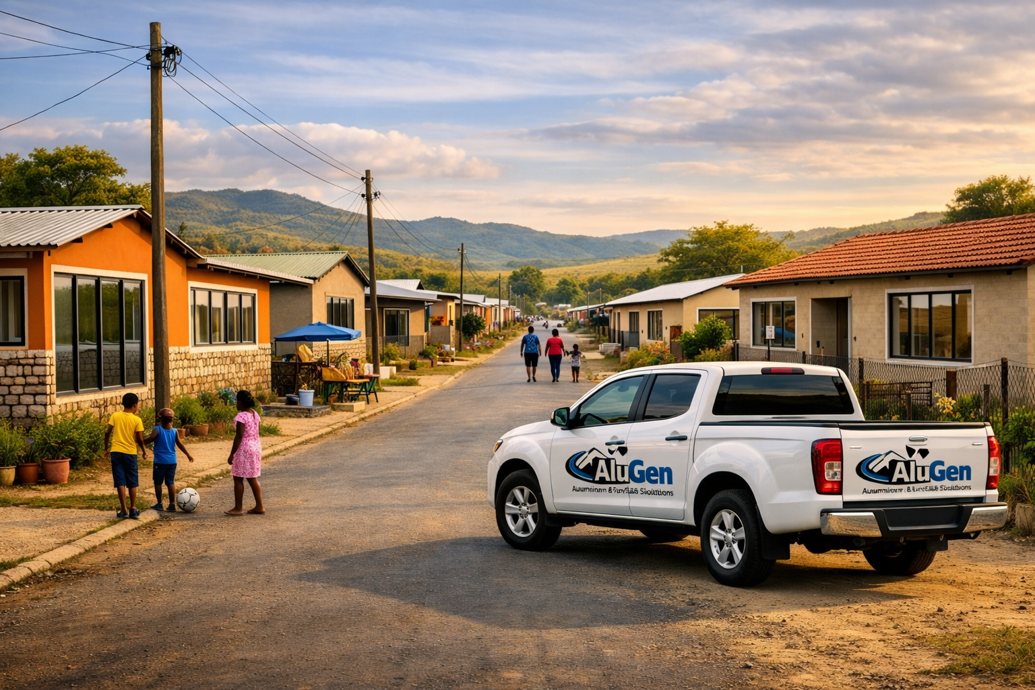
UNDER-SERVED AREAS
Affordable, durable aluminium solutions built for township homes — from burglar-proof windows to stylish front doors that bring security, style, and pride to every household.
We deliver quality aluminium installations that withstand harsh conditions while transforming township homes with modern finishes, improved ventilation, and enhanced security at accessible prices.

Slide 16
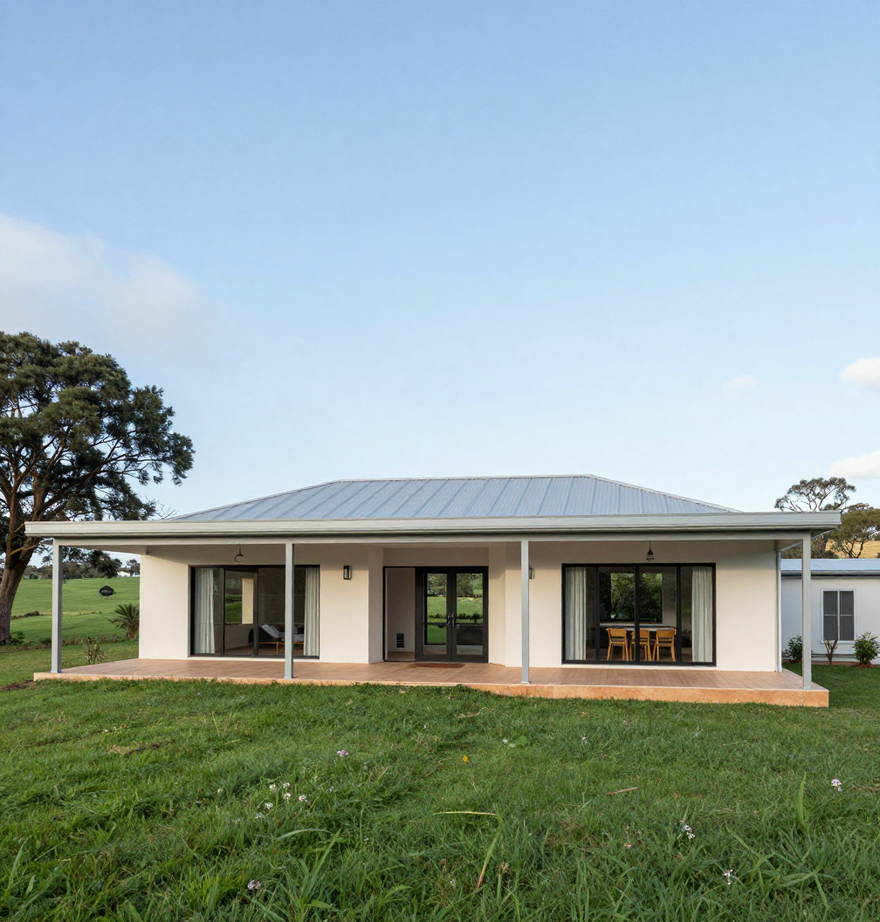
RURAL LIVING
Built for spacious rural properties — large aluminium window frames, veranda enclosures, and farmhouse-style doors that bring modern comfort and security to countryside living.
Our rural installations are engineered to handle wide openings and exposed conditions, delivering robust aluminium and glass solutions that transform farmhouses into modern, light-filled homes.

Slide 17
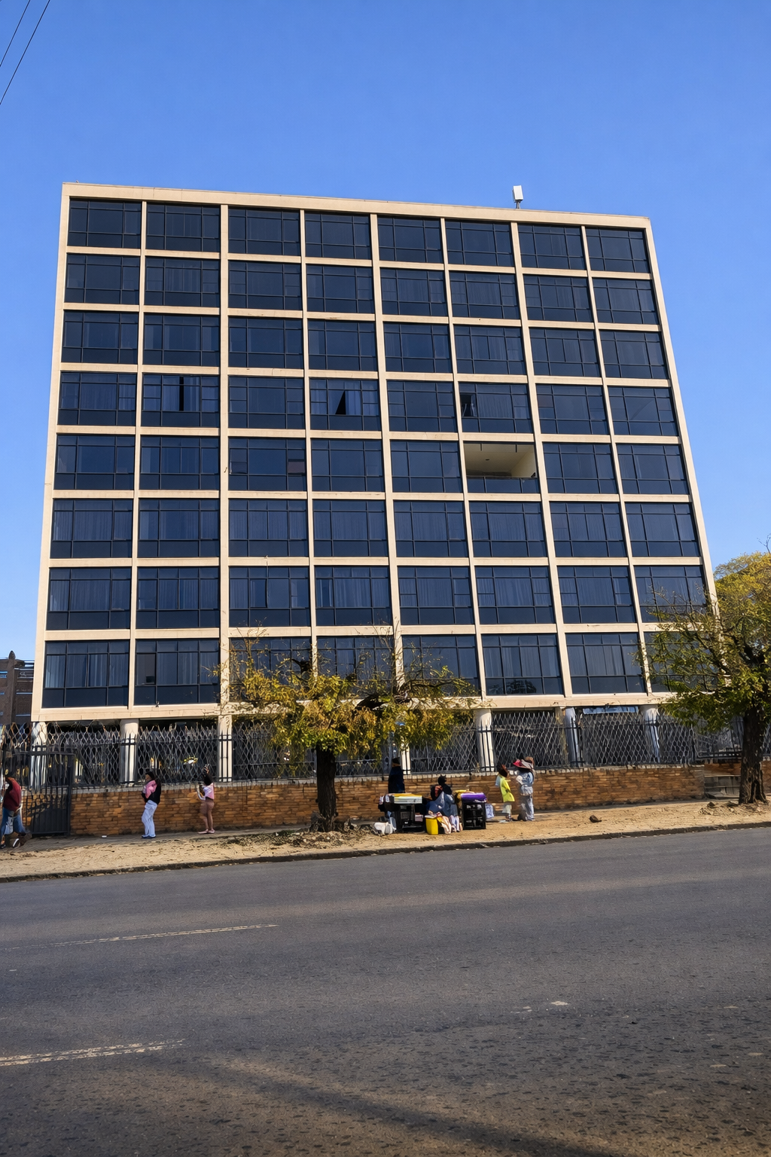
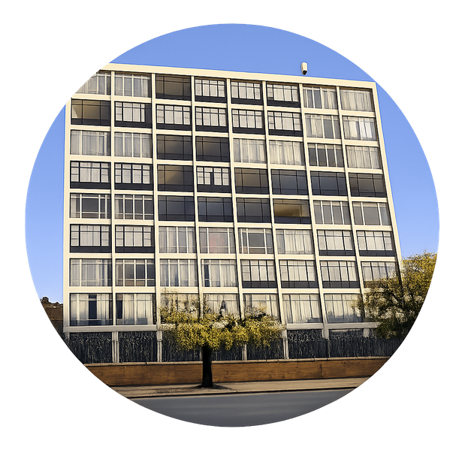
WE TRANSFORM COMMERCIAL SPACES
From outdated storefronts to sleek, modern aluminium-framed facades — we deliver complete commercial renovations that elevate your business image.
"Framing the Future with Aluminium"

Slide 18
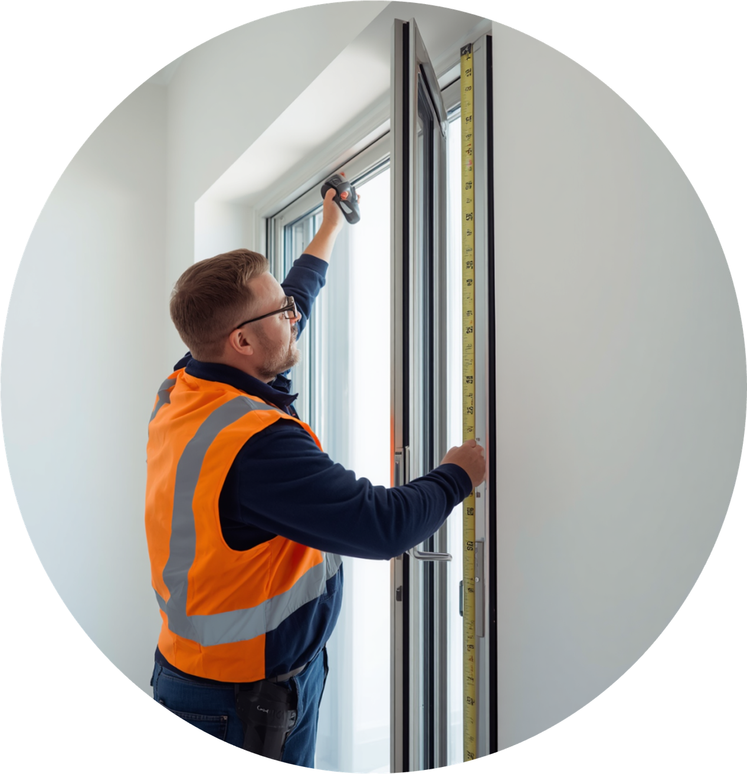
OUR PROCESS
  Site Consultation
  Fabrication
  Quotation & Specifications
  Installation & Quality Assurance
  Technical Assessment
  Final Inspection & Handover

Slide 19

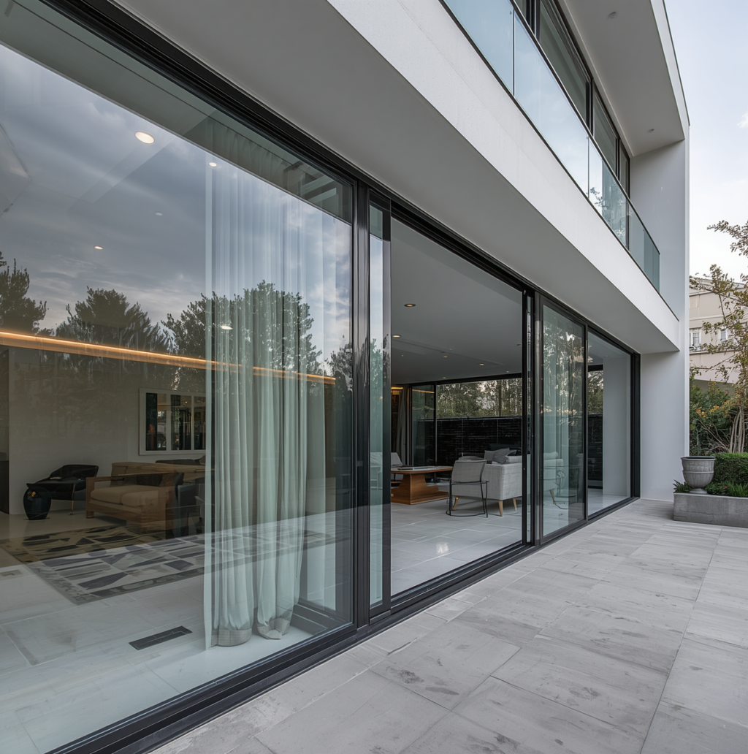
CONTACT US
076 426 7184 | 082 325 0895 | 079 437 5475
Whatsapp to the above numbers, we will call you back
https://www.alugen.co.za
info@alugen.co.za
Precision. Quality. Excellence.
We do not charge for Quotation

